Slide 1
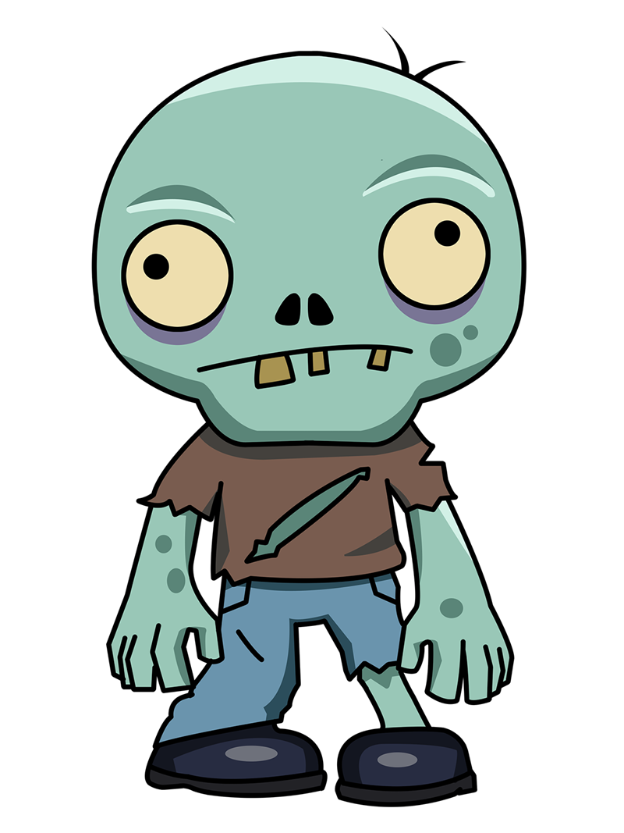
Zombie Mayhem
Can I get some head!
Team: J&J Games
Members: Justin Fan, Joshua Insorio
Zombie Mayhem challenges players to kill zombies chasing you with increasing difficulty.

Slide 2
Alpha Status
Item | Max. Points | Actual Points
Fun to play - peer judged | 15 | 7
Background sound | 5 | 3
Sound FX | 5 | 3
Splash Screen | 2 | 0
Credits – Who did what | 1 | 0
Instructions screen | 2 | 0
Collision detection | 5 | 4
Weapons/damage or scoring system | 15 | 3
New assets | 5 | 5
AI | 15 | 7
Physics | 15 | 15
HUD/UI/GUI | 15 | 10
TOTAL | 100 | 57

Slide 3
Beta Status
Item | Max. Points | Actual Points
Fun to play - peer judged | 15 | 12
Background sound | 5 | 5
Sound FX | 5 | 5
Splash Screen | 2 | 2
Credits – Who did what | 1 | 1
Instructions screen | 2 | 2
Collision detection | 5 | 4
Weapons/damage or scoring system | 15 | 13
New assets | 5 | 5
AI | 15 | 12
Physics | 15 | 15
HUD/UI/GUI | 15 | 10
TOTAL | 100 | 85

Slide 4
Sources
Item | Max | Source
Gameplay, Fun to play - peer judged | 15 | Fortnite, Unity templates
Background sound | 5 | n/a
Sound FX | 5 | Minecraft
Splash Screen | 2 | 381
Credits – Who did what | 1 | 381
Instructions screen | 2 | 381
Collision detection | 5 | Unity Collider, circle collisions 381
Weapons/damage or scoring system | 15 | Asset Store, 381
New assets | 5 | Unity Asset Store
AI | 15 | 381
Physics | 15 | Unity rigid body, 381
HUD/UI/GUI | 15 | Team, Asset Store

Slide 5


